Slide 1
FLOOD MONITORING AND CONTROL MEASURE
Team members
1.SHIVANI.S
2.THARA.S
3.SARANYA.S
4.SREE SANJANA.D

Slide 2


Slide 3
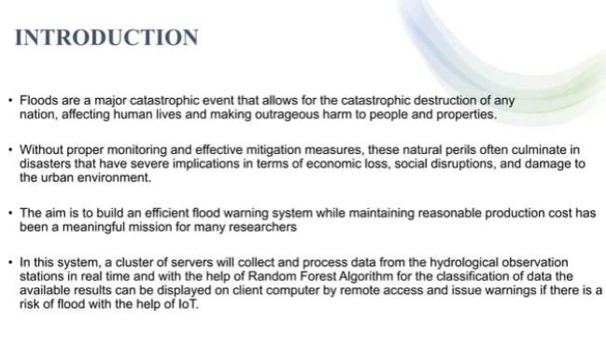

Slide 4
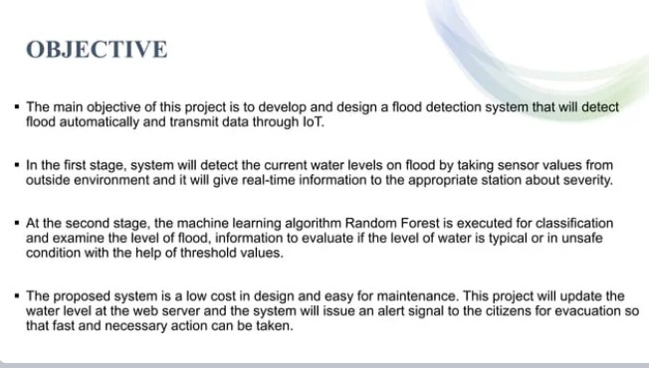

Slide 5


Slide 6
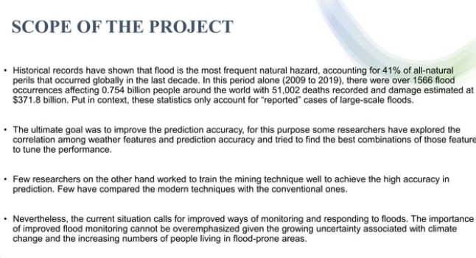

Slide 7
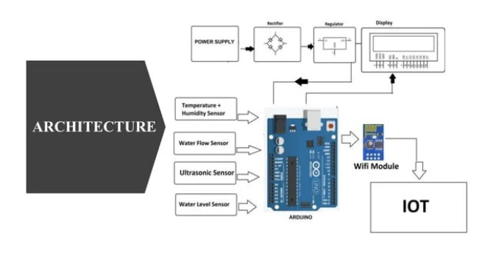

Slide 8
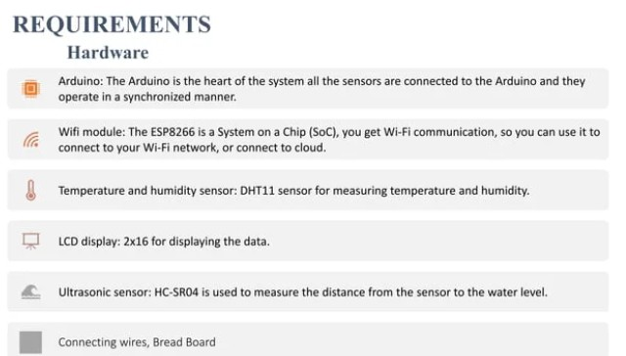

Slide 9
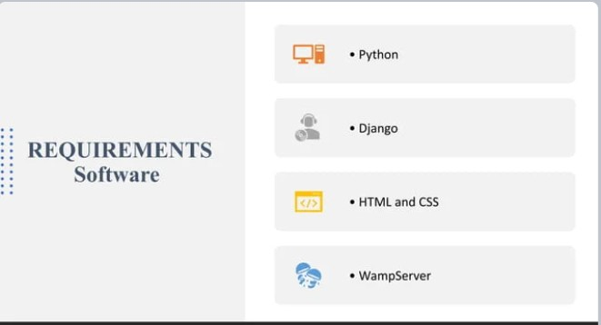

Slide 10
